Slide 1
November Monthly Meeting

Slide 2
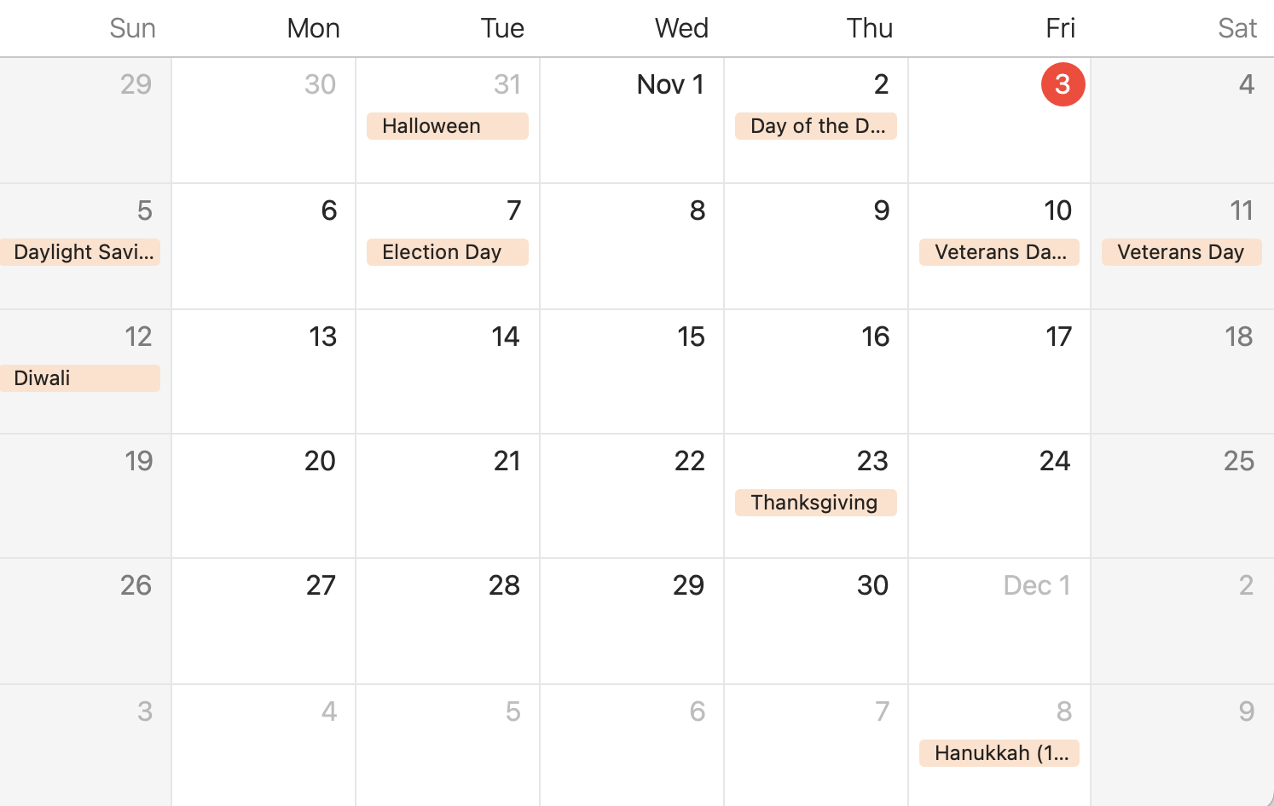
Calendar
Nov. 4th-General Meeting and FoodBank event
Nov. 10th- Learning and Development in the Wild
Nov. 12th- Bowling Afternoon
Nov. 13th- LinkedIn Workshop
Dec. 2nd- Networking Mixer
Dec. 9th- Semester Banquet
Reminders:
11/5: Last day to order stole/cord
11/20: Scholarship application due
11/20: Officer application due
All of the events are opportunities to pick up t-shirts EXCEPT November 13th.

Slide 3
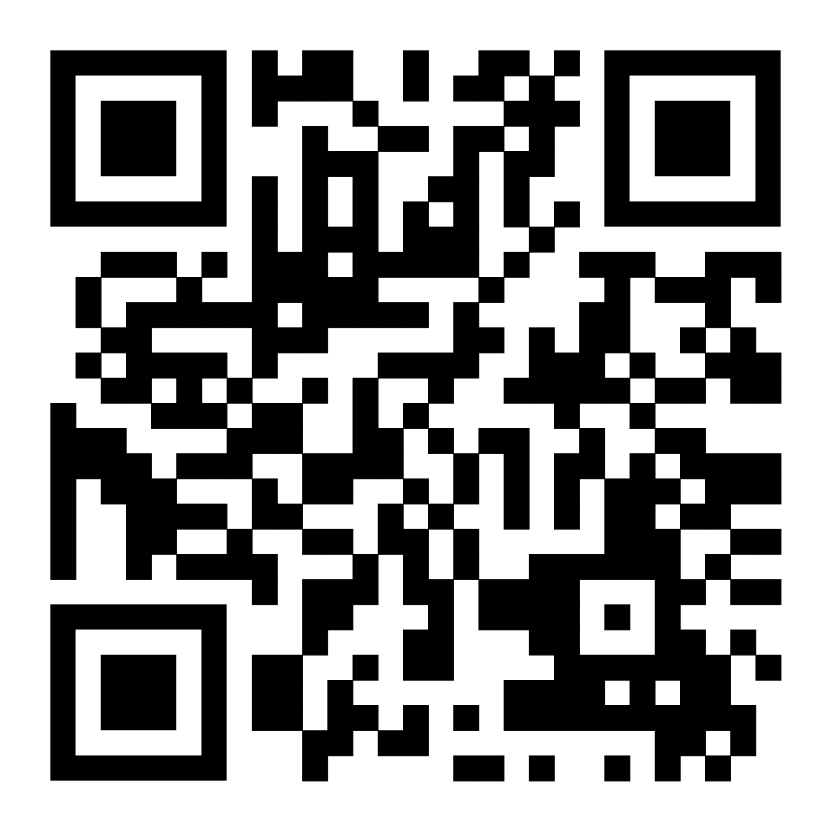
Stoles and Cords
LAST DAY TO ORDER AND PAY FOR YOUR STOLE AND CORD IS TOMORROW, (SUNDAY ) 11/5

Slide 4
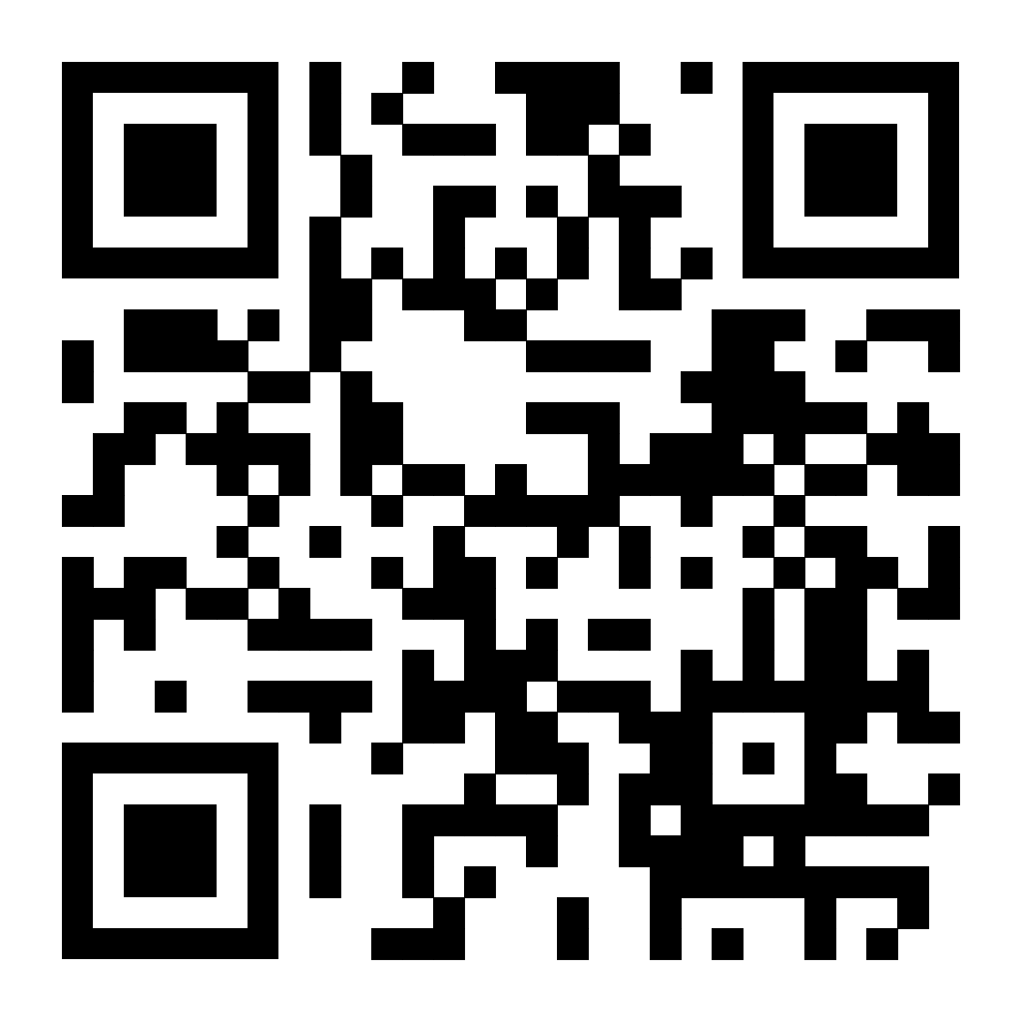
Scholarships
Applications Open: 11/04/2023
Applications Close: 11/20/2023
Scholarship Recipients::
-Recipients cannot have won a Spring ‘23 Scholarship.
-2 winners will be chosen by an anonymous judge.
-Recipients will be recognized at the semester banquet, 12/9/2023.

Slide 5
Events

Slide 6
Professional
11/10 in the Space City Room (SCS)
Pizza will be provided by CVR Energy

Slide 7
Professional

Slide 8
Social
DEADLINE TO FILL OUT FORM: 11/7

Slide 9
SSHRD
Officer
Program
Information
Roles
Applications

Slide 10
Information
About: Being an officer is extremely rewarding! It is a great way to connect with UH, professionals, the Houston community, and so many others. Creating events, flyers, and building connections are just some of the perks of being an officer. This looks great on a resume/LinkedIn profile, and can teach you a lot about leadership and planning.
Leadership experience - Networking Opportunities - Skill Development - Access to Resources - Visibility
Perks:
Hands on insight and experience in real-world settings
Priority mentor selection
Creative freedom to choose semester events
Boosts your LinkedIn connections
FREE lifetime membership
FREE officer polo
FREE t-shirt (for the term you serve in an officer role)
FREE stole and cord (for your graduating semester)
NO EXPERIENCE NECESSARY! Everyone has unlimited potential to to represent SSHRD as an officer. We highly encourage you to investigate this opportunity!
Please reach out to any officer for questions.

Slide 11
Overview of Roles
President
Vice President
Secretary
Spearheads mentorship program.
Orchestrates ordering of T-Shirts, Stoles, and Cords.
Works heavily with secretary and PDR for events and point management.
Work with Pres. on registration and monthly RSVPS.
Manages points spreadsheet.
Keeps track of member status.
Head of officer team.
Main liaison between org. and school.
Leads semester registration.
Oversees financials, events, meetings, and all org. functions.
Event Coordinator
Professional Development Rep.
Social Media and Recruitment Dir.
Plans & Organizes Events
Builds and maintains connections with campus and Houston community.
Provides guidance on career development, resume building, and networking opportunities.
Manages SSHRD’s Linkedin Page
Builds and maintains connections and resources including with ATD, HR Houston, and other professionals.
Manages org. presence on social media - creates weekly posts on SSHRD Instagram.
Emails monthly newsletter.
Collabs with other officers to creates flyers for org. needs.

Slide 12
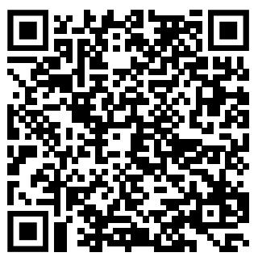
Applications
Applications Open: 11/4
Applications Close: 11/20
Interviews Held: 11/27-11/30 on TEAMS
President will reach out to schedule interviews. Candidates will be notified following interviews.
Officers Announced: 12/9 at our Semester Banquet

Slide 13
Banquet Reminder
MUST RSVP BY 11/17 NO EXCEPTIONS
Time: 1-3pm
Location: SCS Room TBA
Menu: Salad, Pasta, Marinara and Alfredo Sauce, Dessert, Lemonade
Dress: Dressy Casual
Guest tickets may be purchased for $20 through PayPal or PayPal donation.
Please reach out to President for questions.

Slide 14
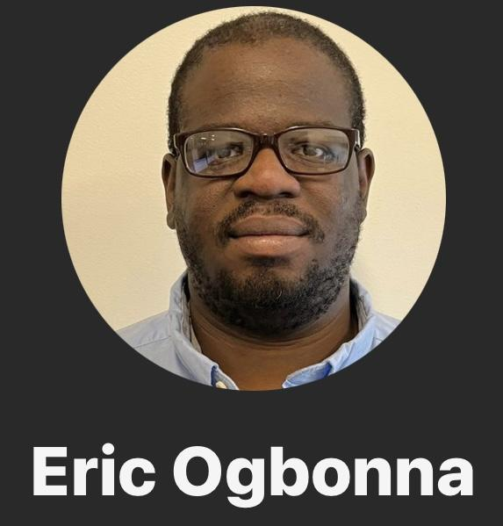
Member of the Month

Slide 15
Mentorship Champion of the Month
Cynthia Sanchez

Slide 16
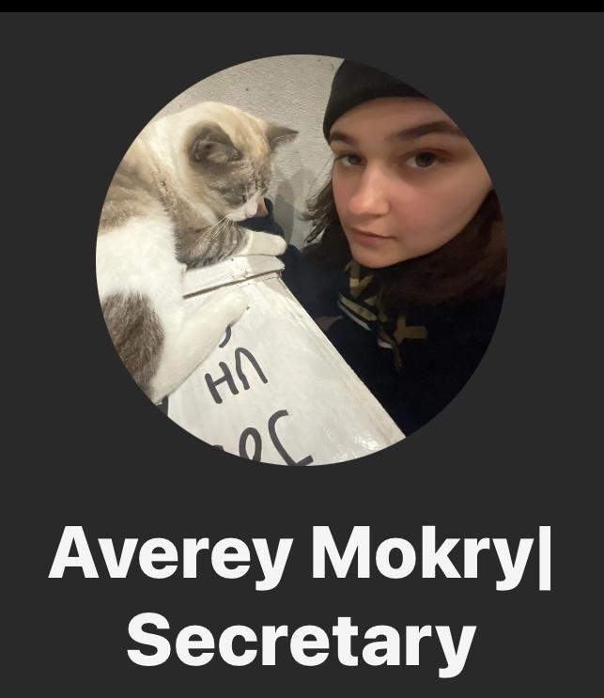
Officer of the Month

Slide 17
Serita Doku
Giselle Lara
Happy Birthday to…
Johnny Duong
Elizabeth Reid
Cindy Cisneros
Amber Childress
Randy Caraballo
Eric Ogbonna

Slide 18
Thanks!

