Slide 1
October Monthly Meeting

Slide 2
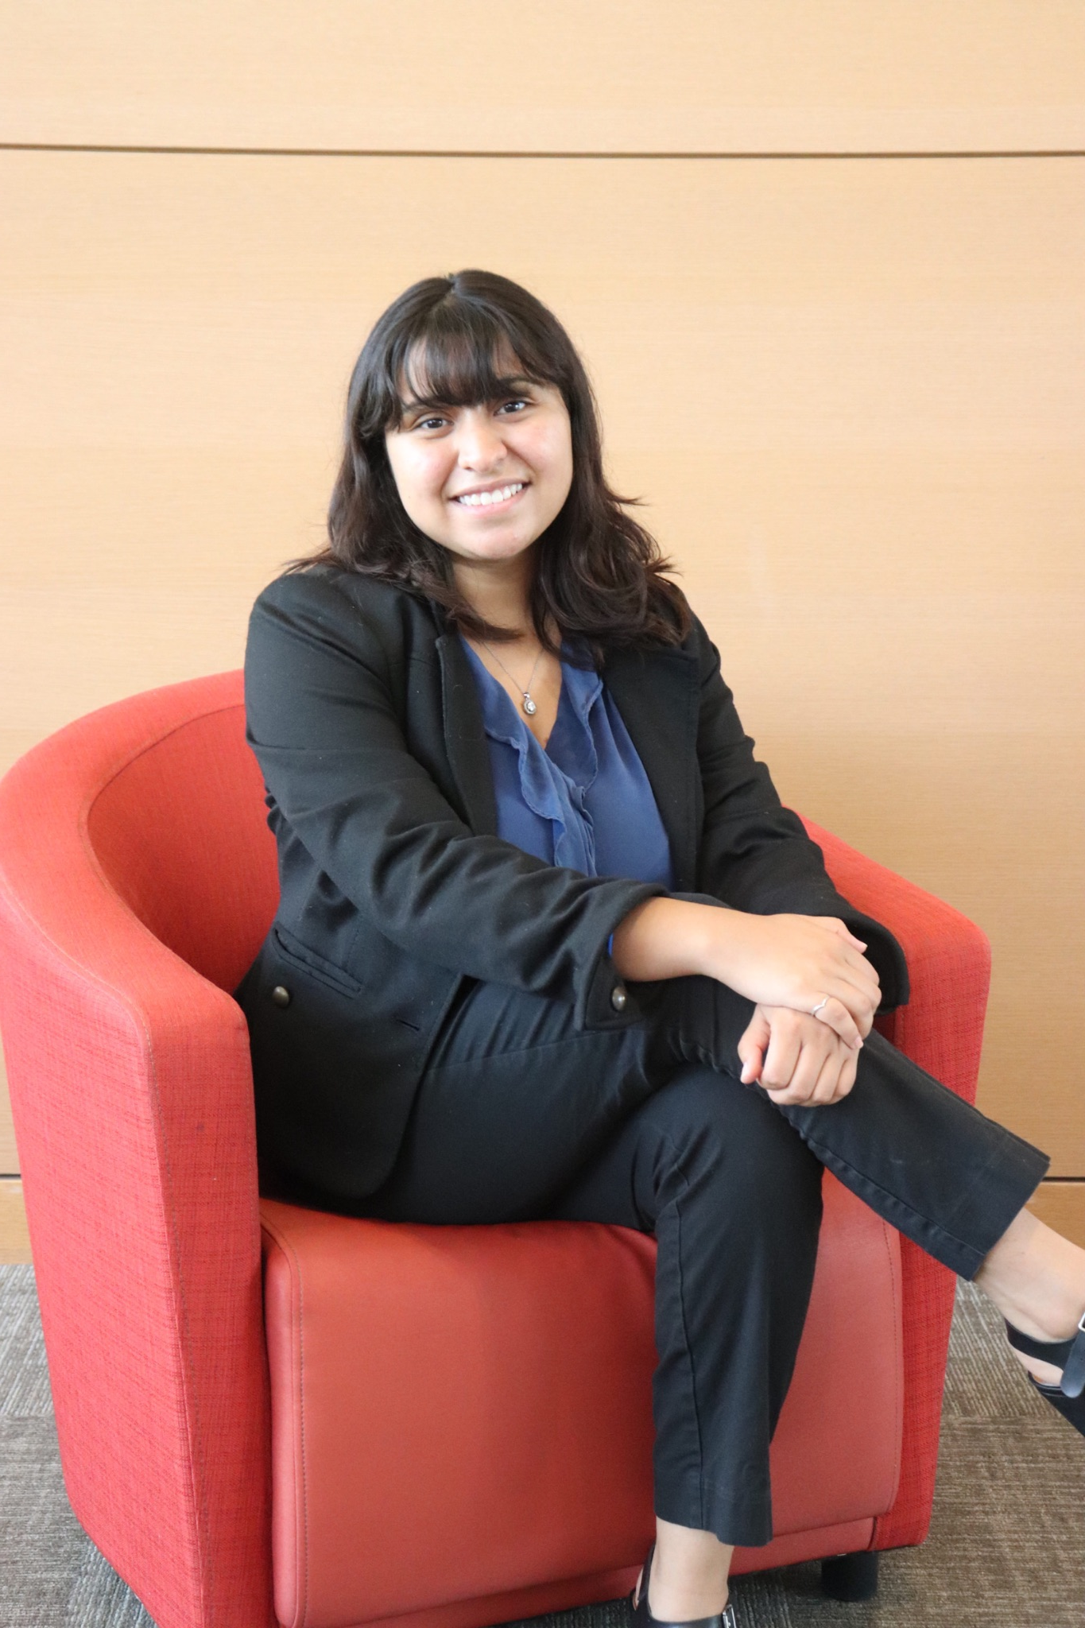
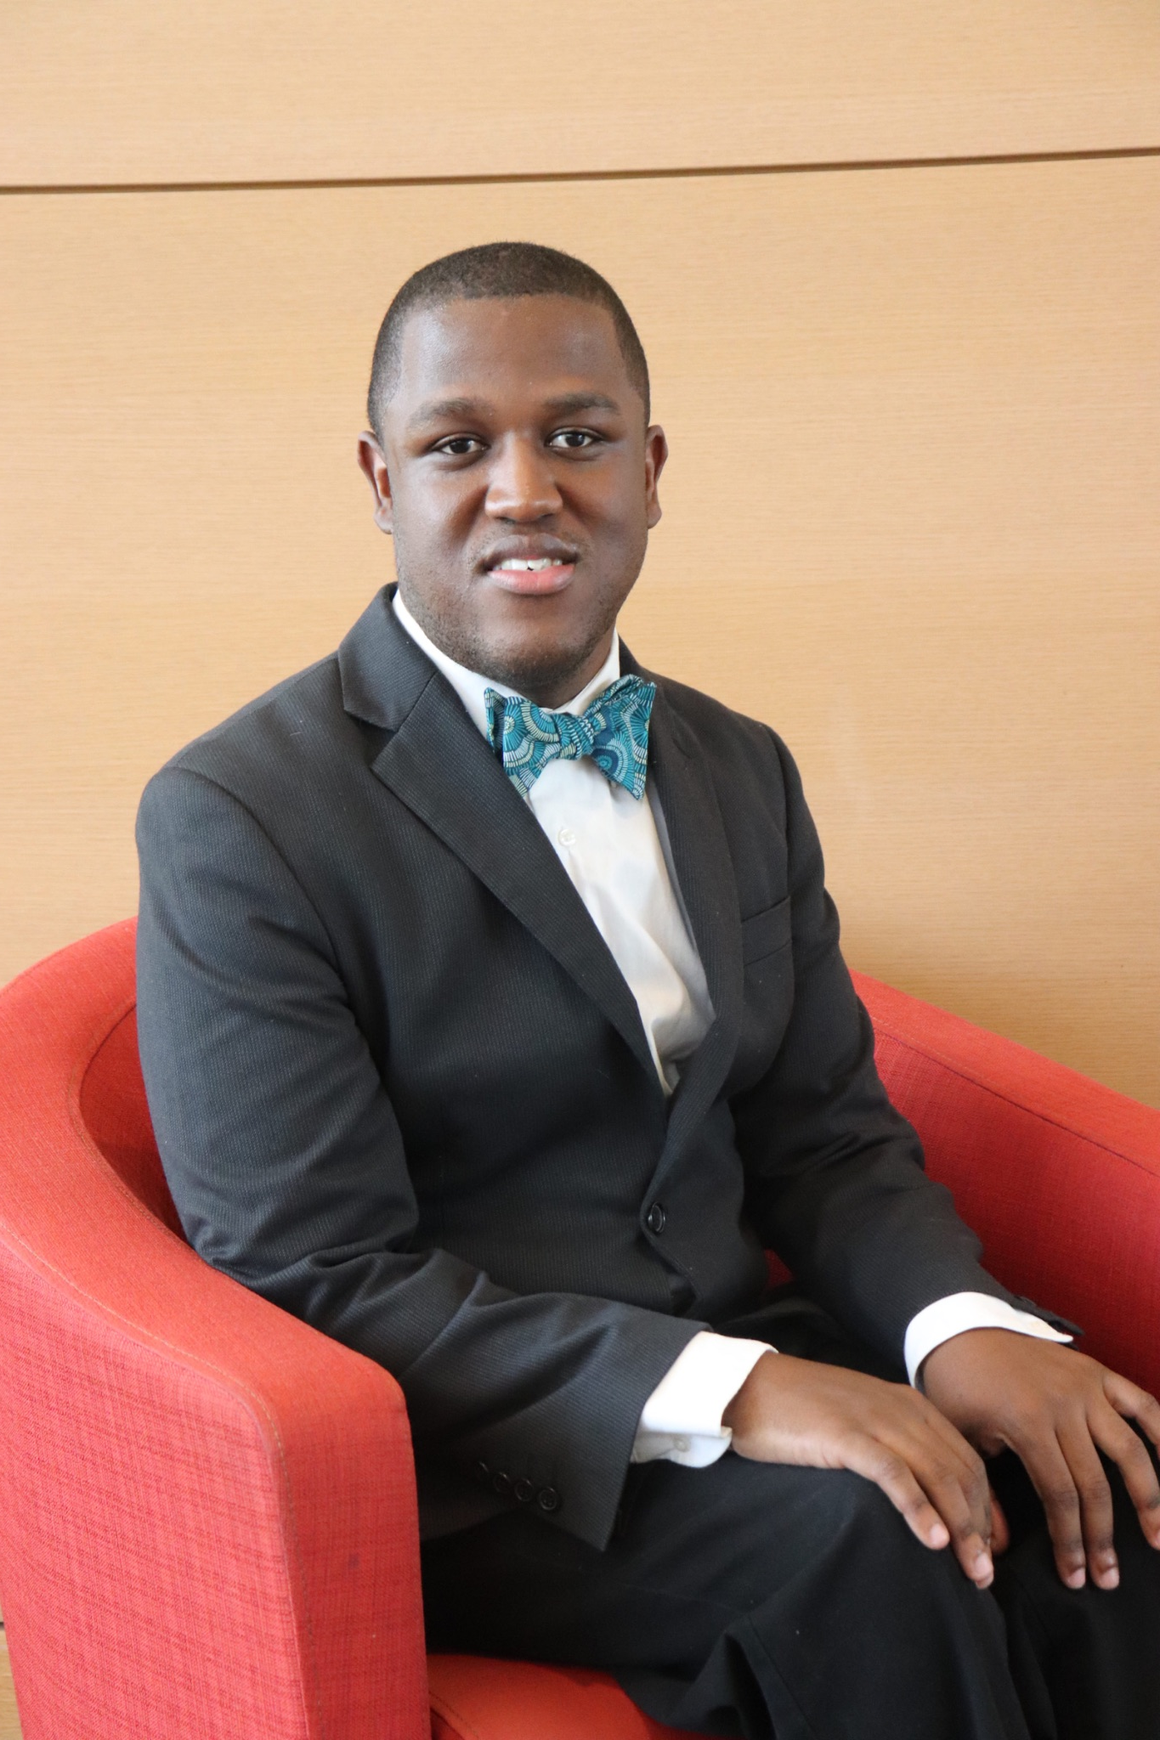
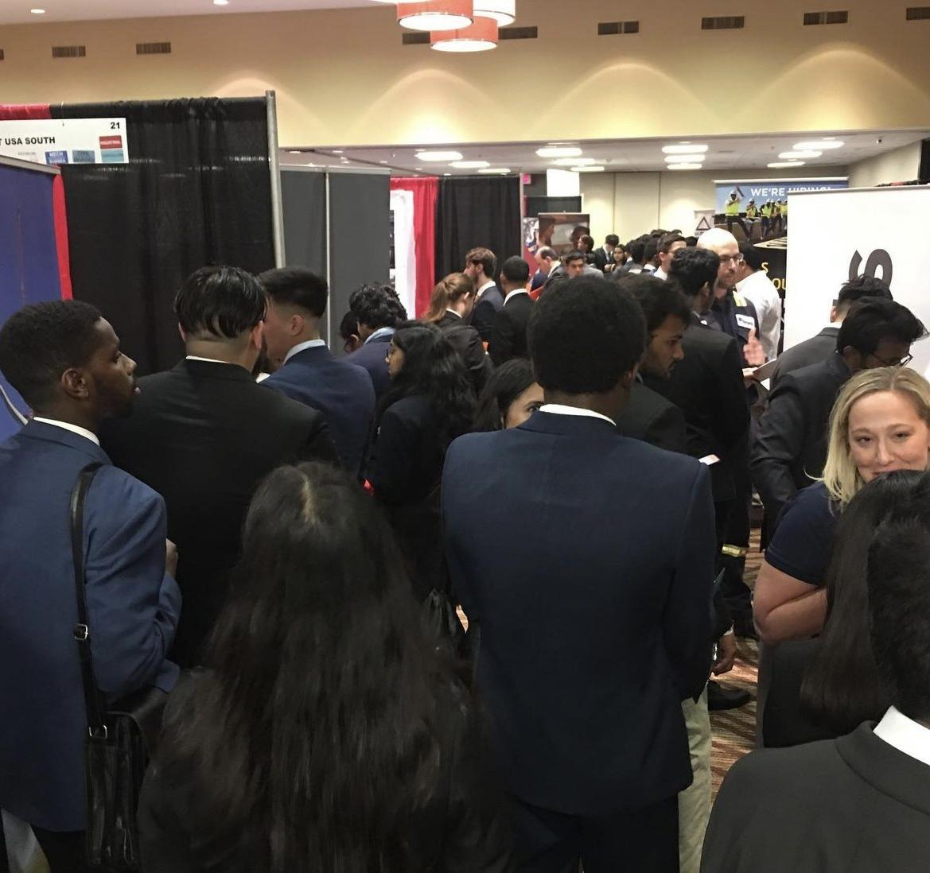
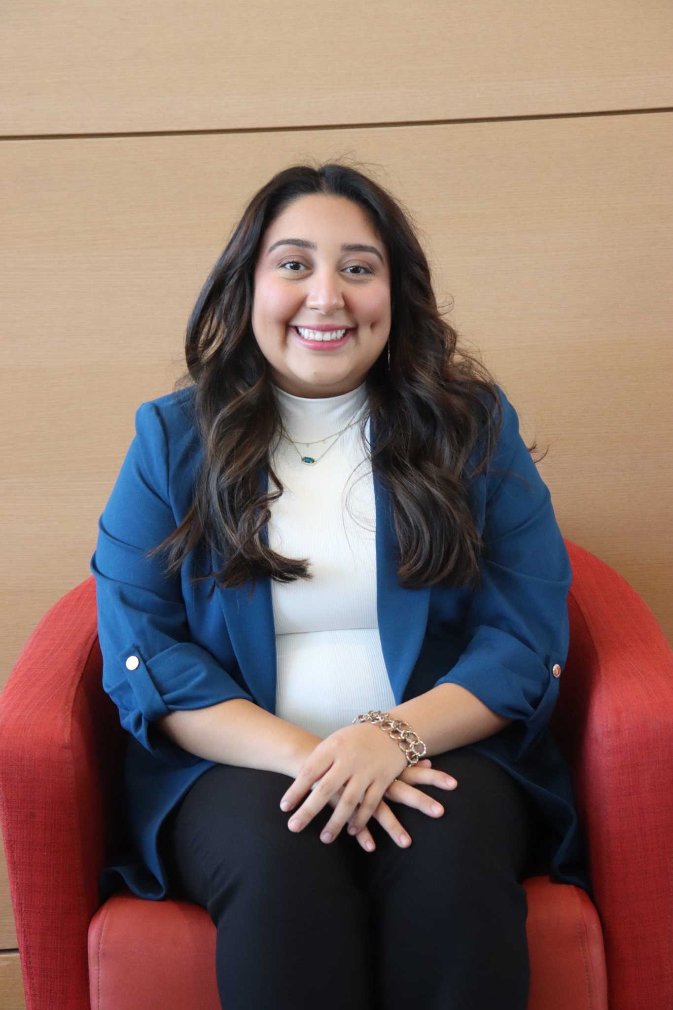
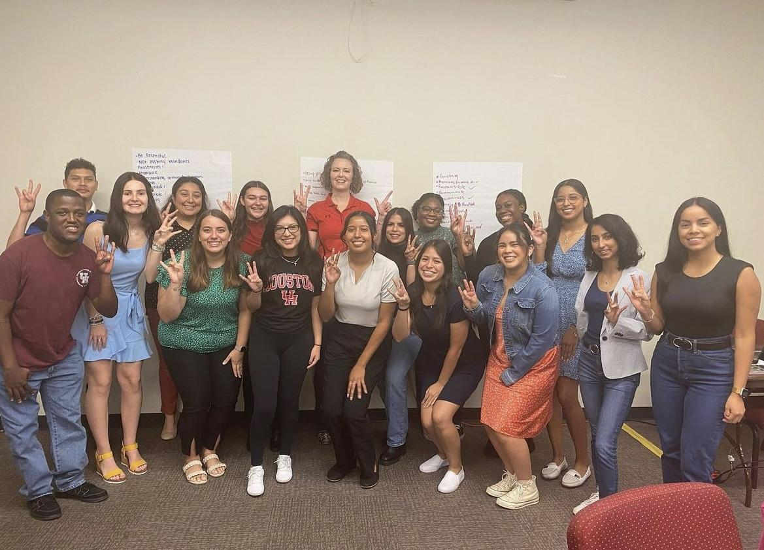
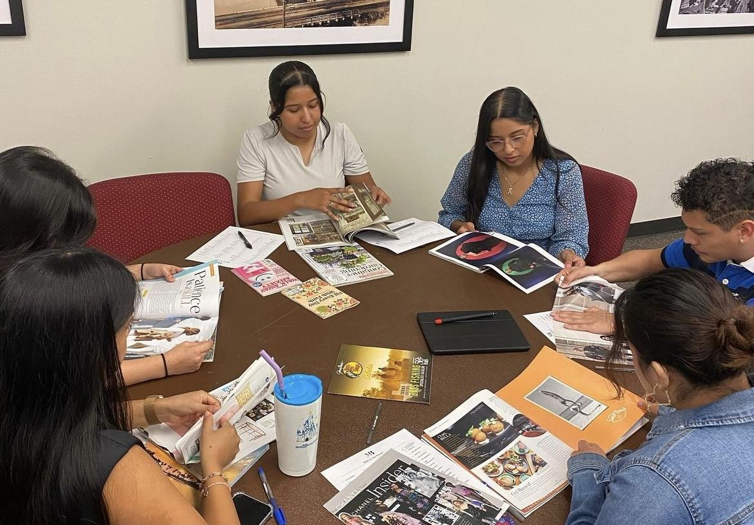
February Recap

Slide 3
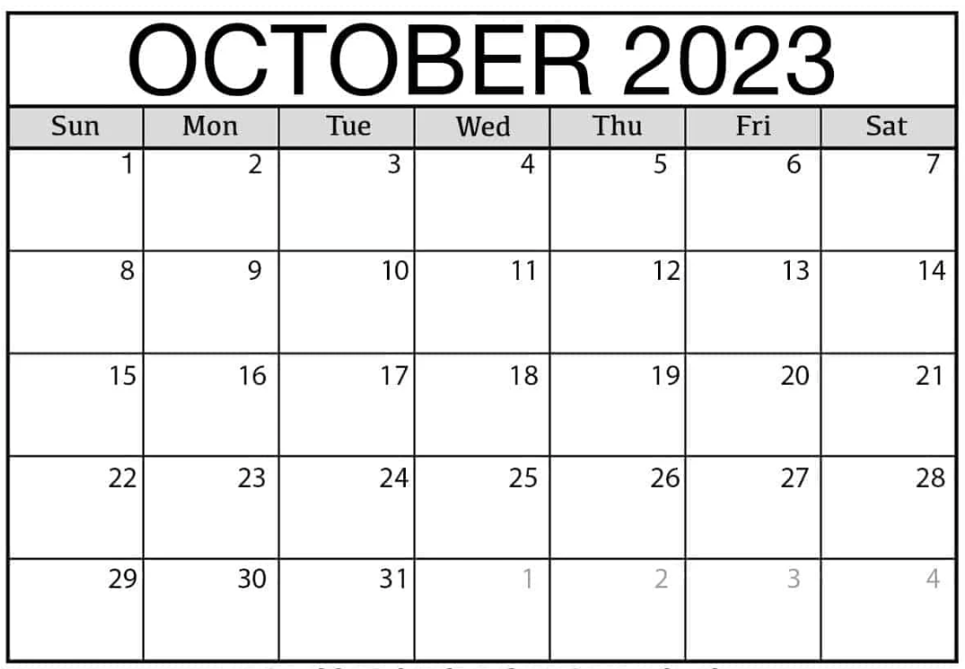
October Calendar
7th (today)- Painting Social
13th and 14th- Creating Healthy Cultures
16th- Find Your Path on TEAMS
27th- Karaoke Night
Nov. 4th- Monthly Meeting on TEAMS
Nov. 4th- Volunteer event with IMSPIRE
T-shirt Pick Up Opportunity

Slide 4
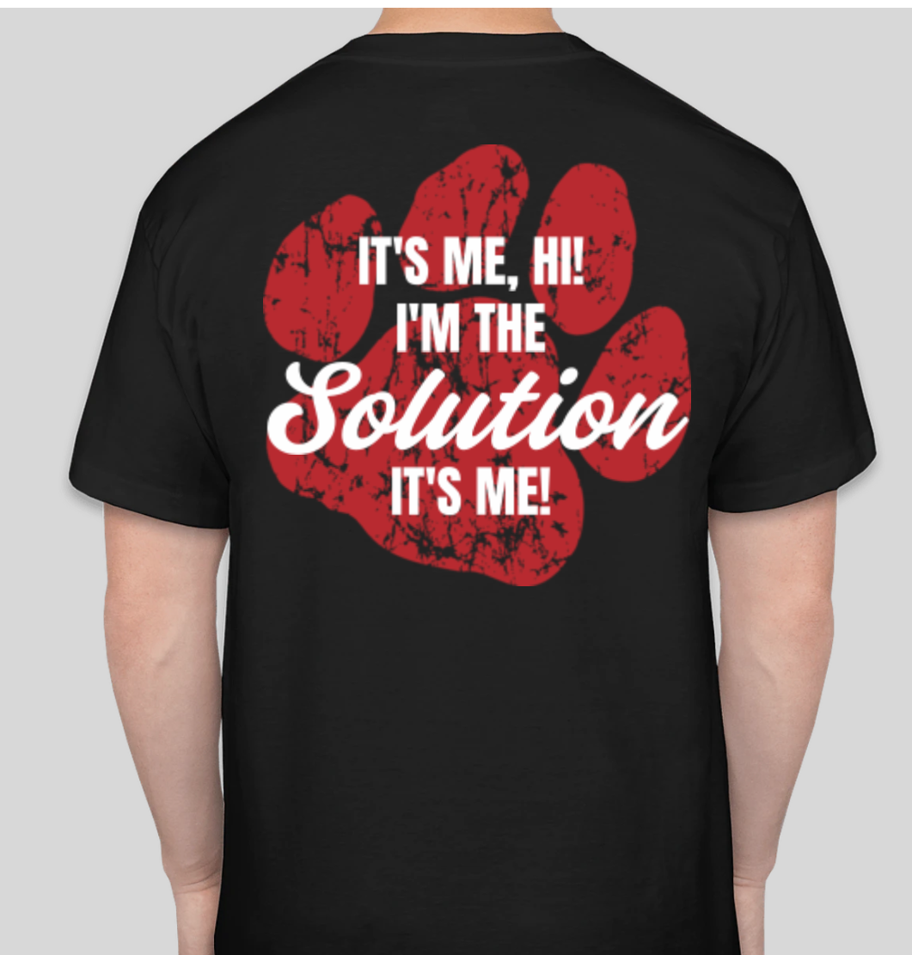
T-Shirt Update
Pick up Dates:
-Creating Healthy Cultures 10/14
- Karaoke Night 10/27
-Learning and Development in the Wild 11/10

Slide 5
Stoles and Cords
Reach out to Averey if there are any point discrepancies!
secretary.sshrd@gmail.com
Keep an eye out for the google form to purchase a stole and cord if you are not eligible based on points!
Price: $35
Check the website to confirm your points!

Slide 6
Events

Slide 7
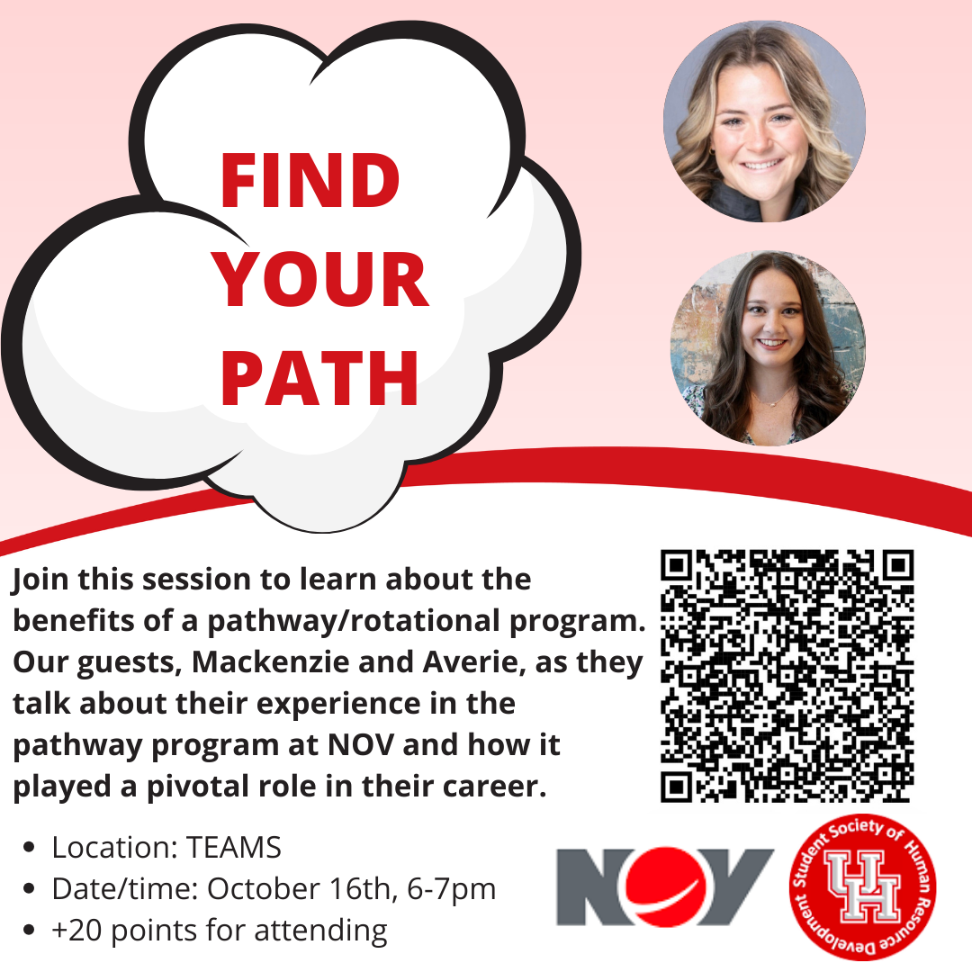
Professional Development

Slide 8
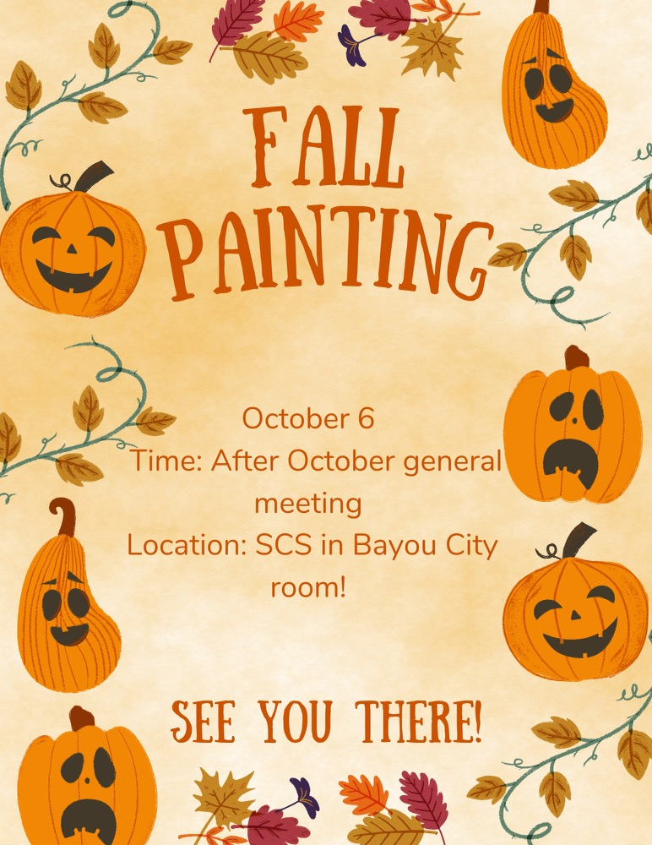
Social and Fundraising Events
Save the Date
Karaoke Night
October 27th
6:00pm-8:00pm
SCS-Room Pending
TODAY

Slide 9
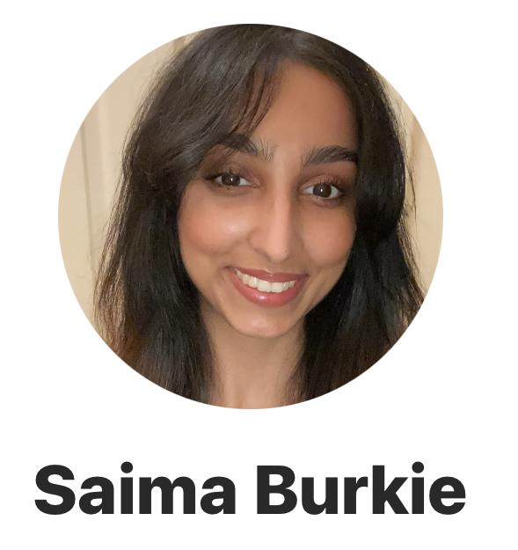
Member of the Month

Slide 10
Officer of the Month

Slide 11
Mentorship Champion Award
Rachel Dang
Notes:
Given to the member who consistently demonstrates exceptional dedication to their mentor, going above and beyond to make the most out of the mentorship relationship

Slide 12
Mentorship Program Update
Volunteer Event
Banquet
Mentorship Project
Notes:
Given to the member who consistently demonstrates exceptional dedication to their mentor, going above and beyond to make the most out of the mentorship relationship

Slide 13
Save the Date for our
Banquet
Saturday December 9th
1pm-3pm

Slide 14
Happy Birthday October Babies!
Jessica Valero
Tiffany Davis
Javier Molina
Jocelyn Cox
Ayush Das
Emen Umoh
Chris Oliveras
Elizabeth Flores
Stephany Flores
Amy Nelson
Arely Romero

Slide 15
Thank you!

