Slide 1
September
Monthly Meeting
Welcome to SSHRD!
Notes:
Emily

Slide 2
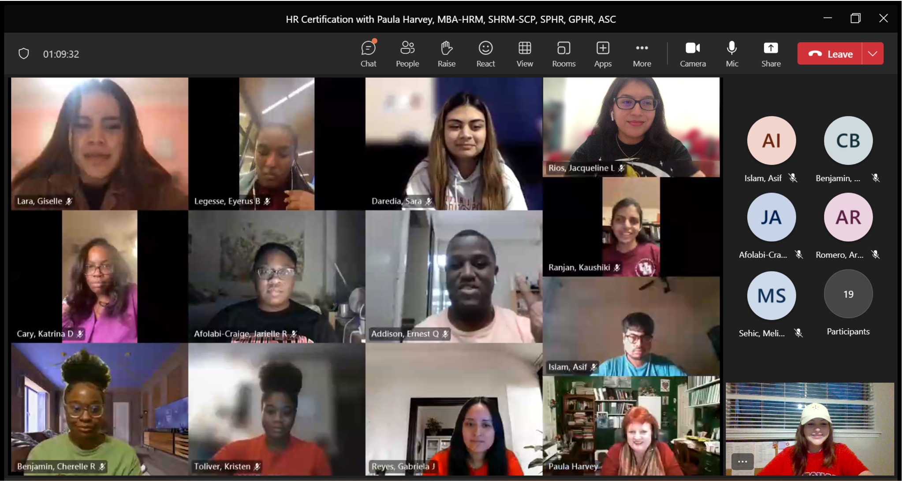
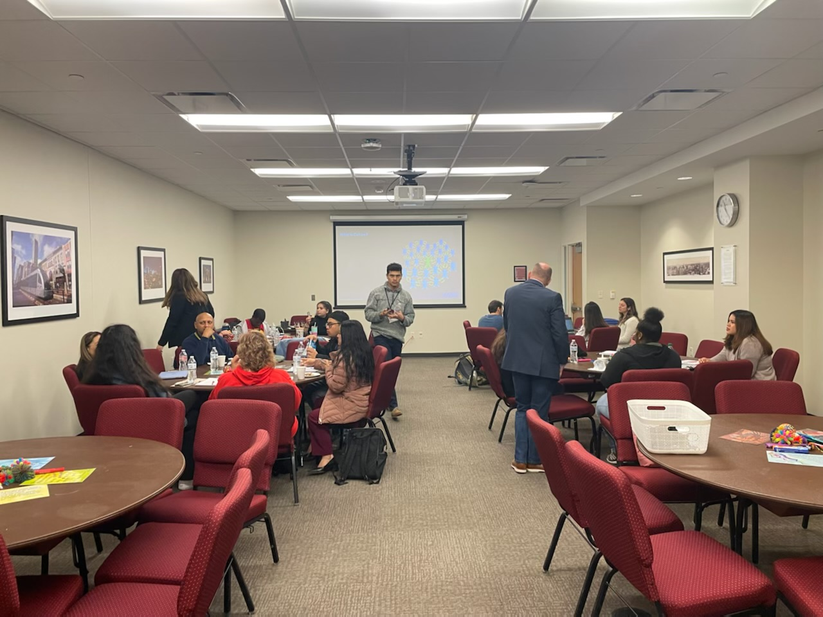
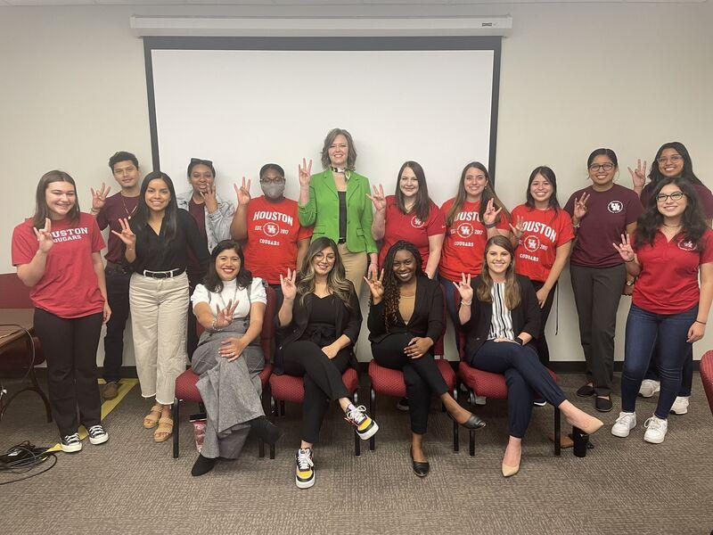
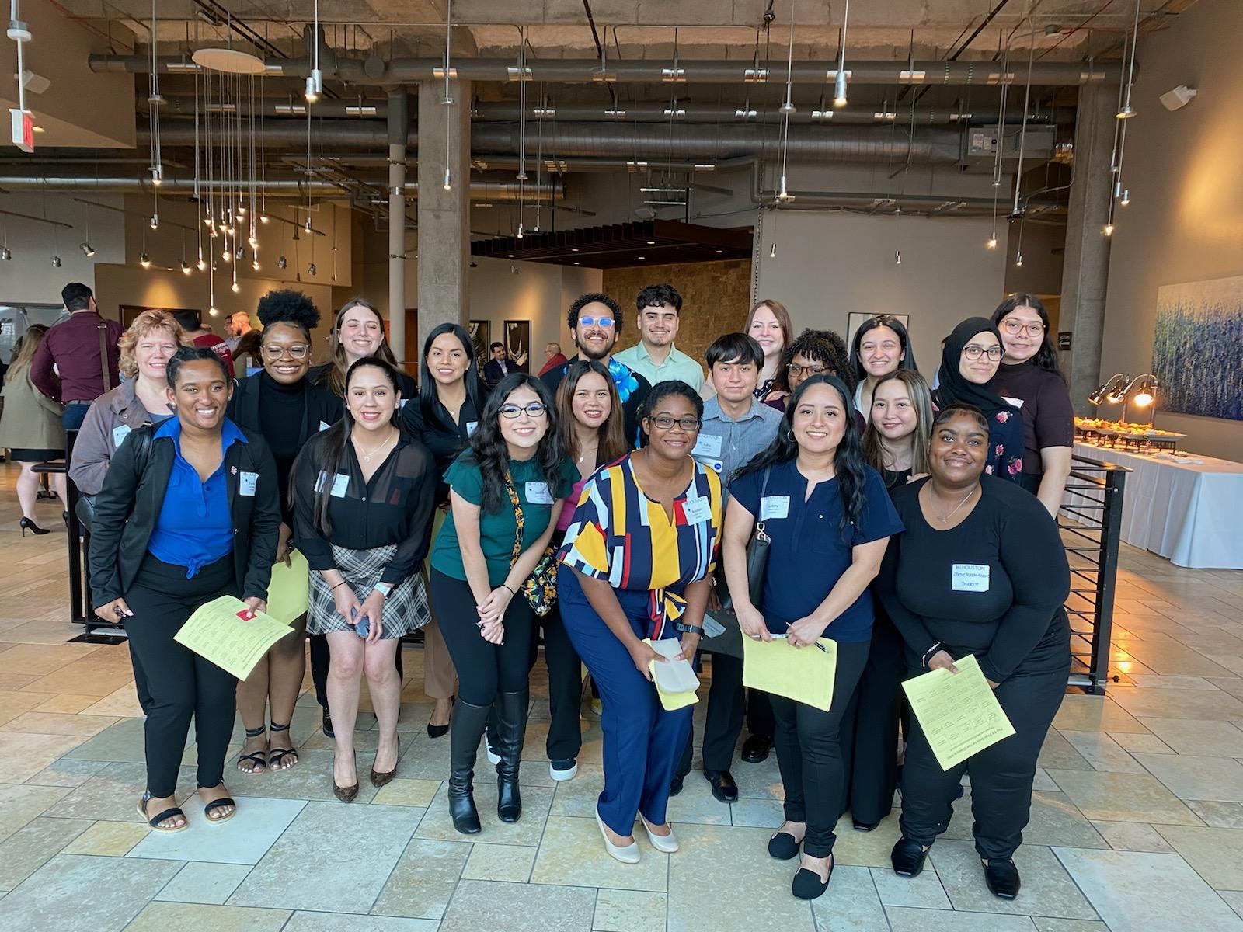
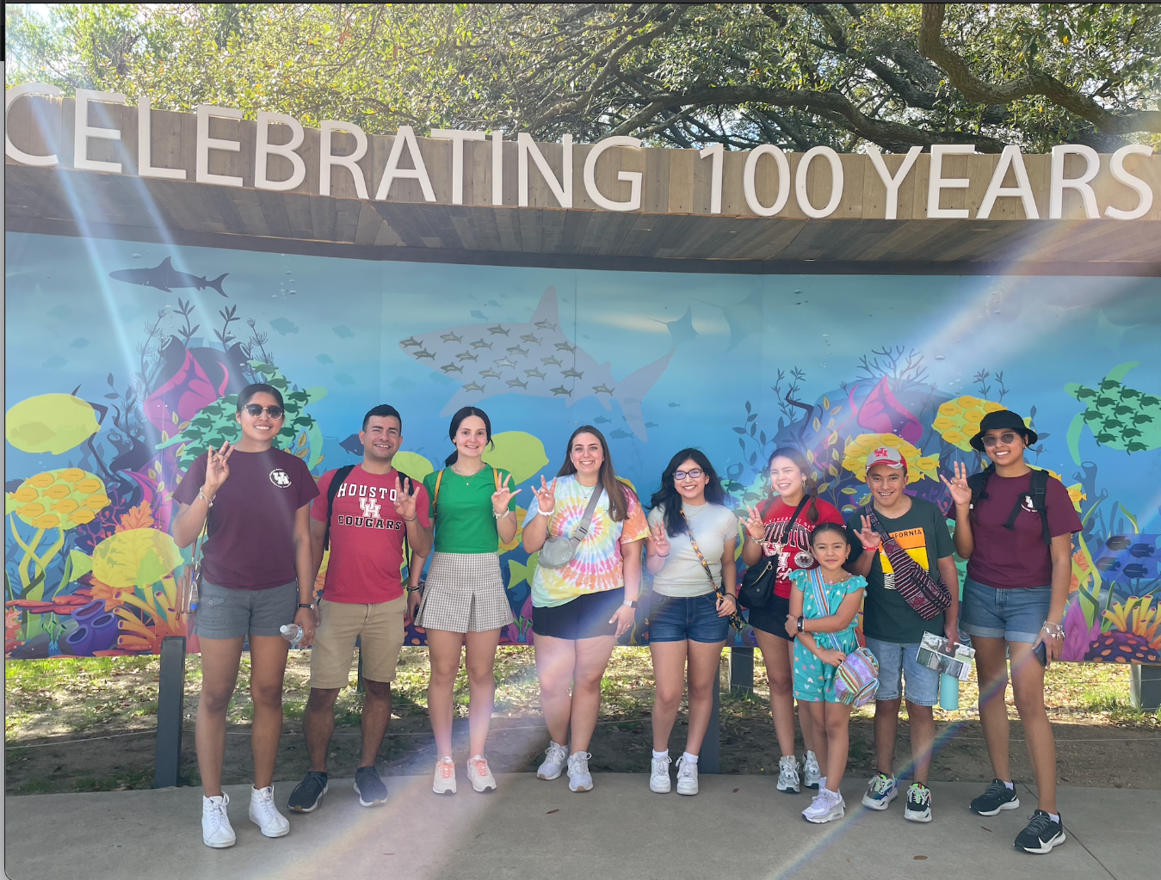
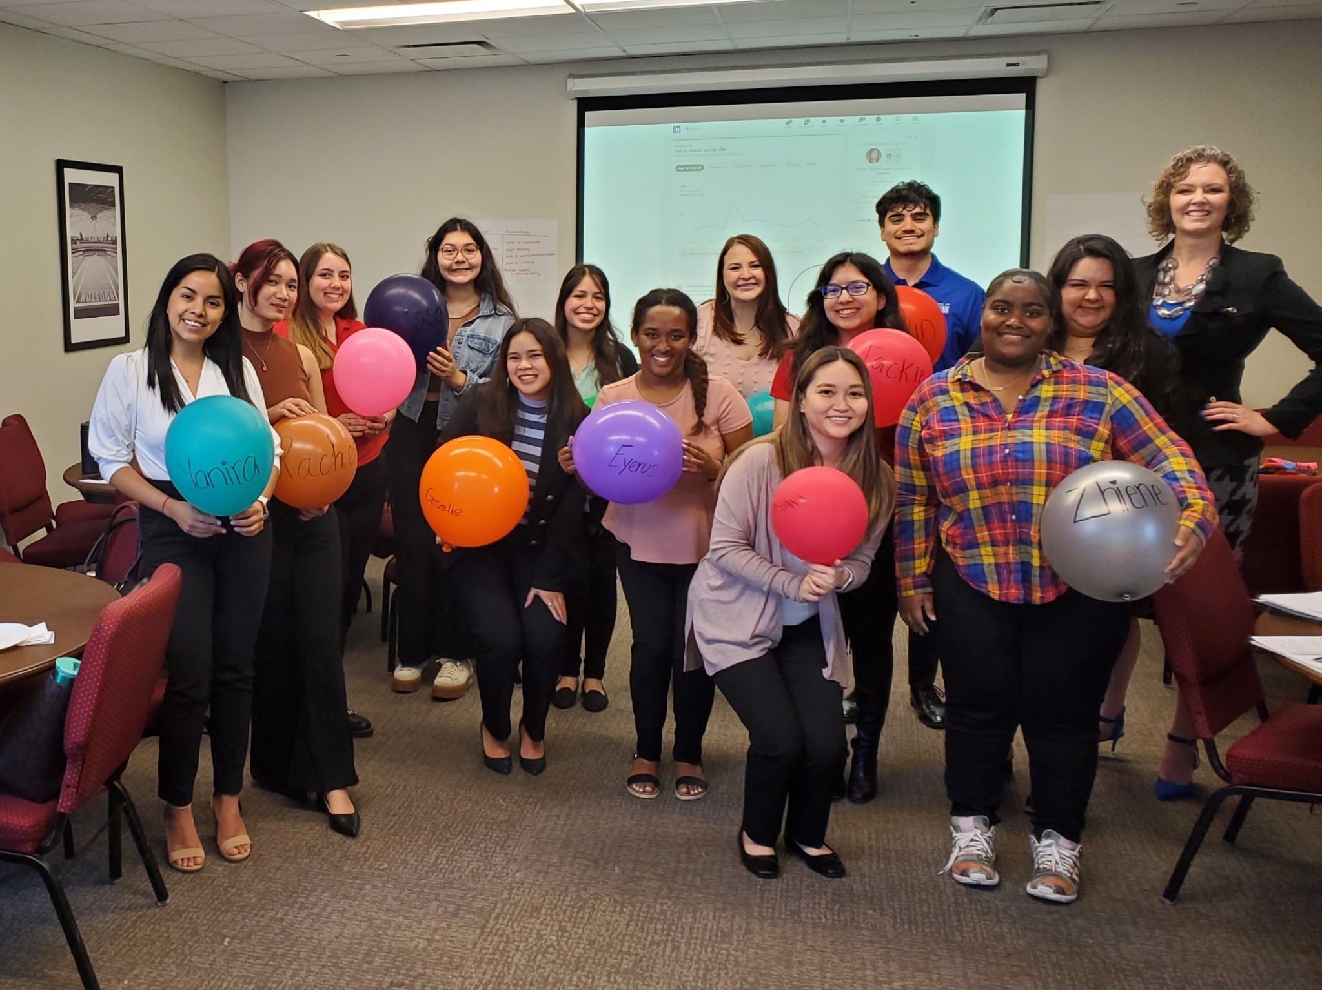
Spring 2023 Recap
Notes:
Emily

Slide 3
Fall 2023
Officers

Slide 4
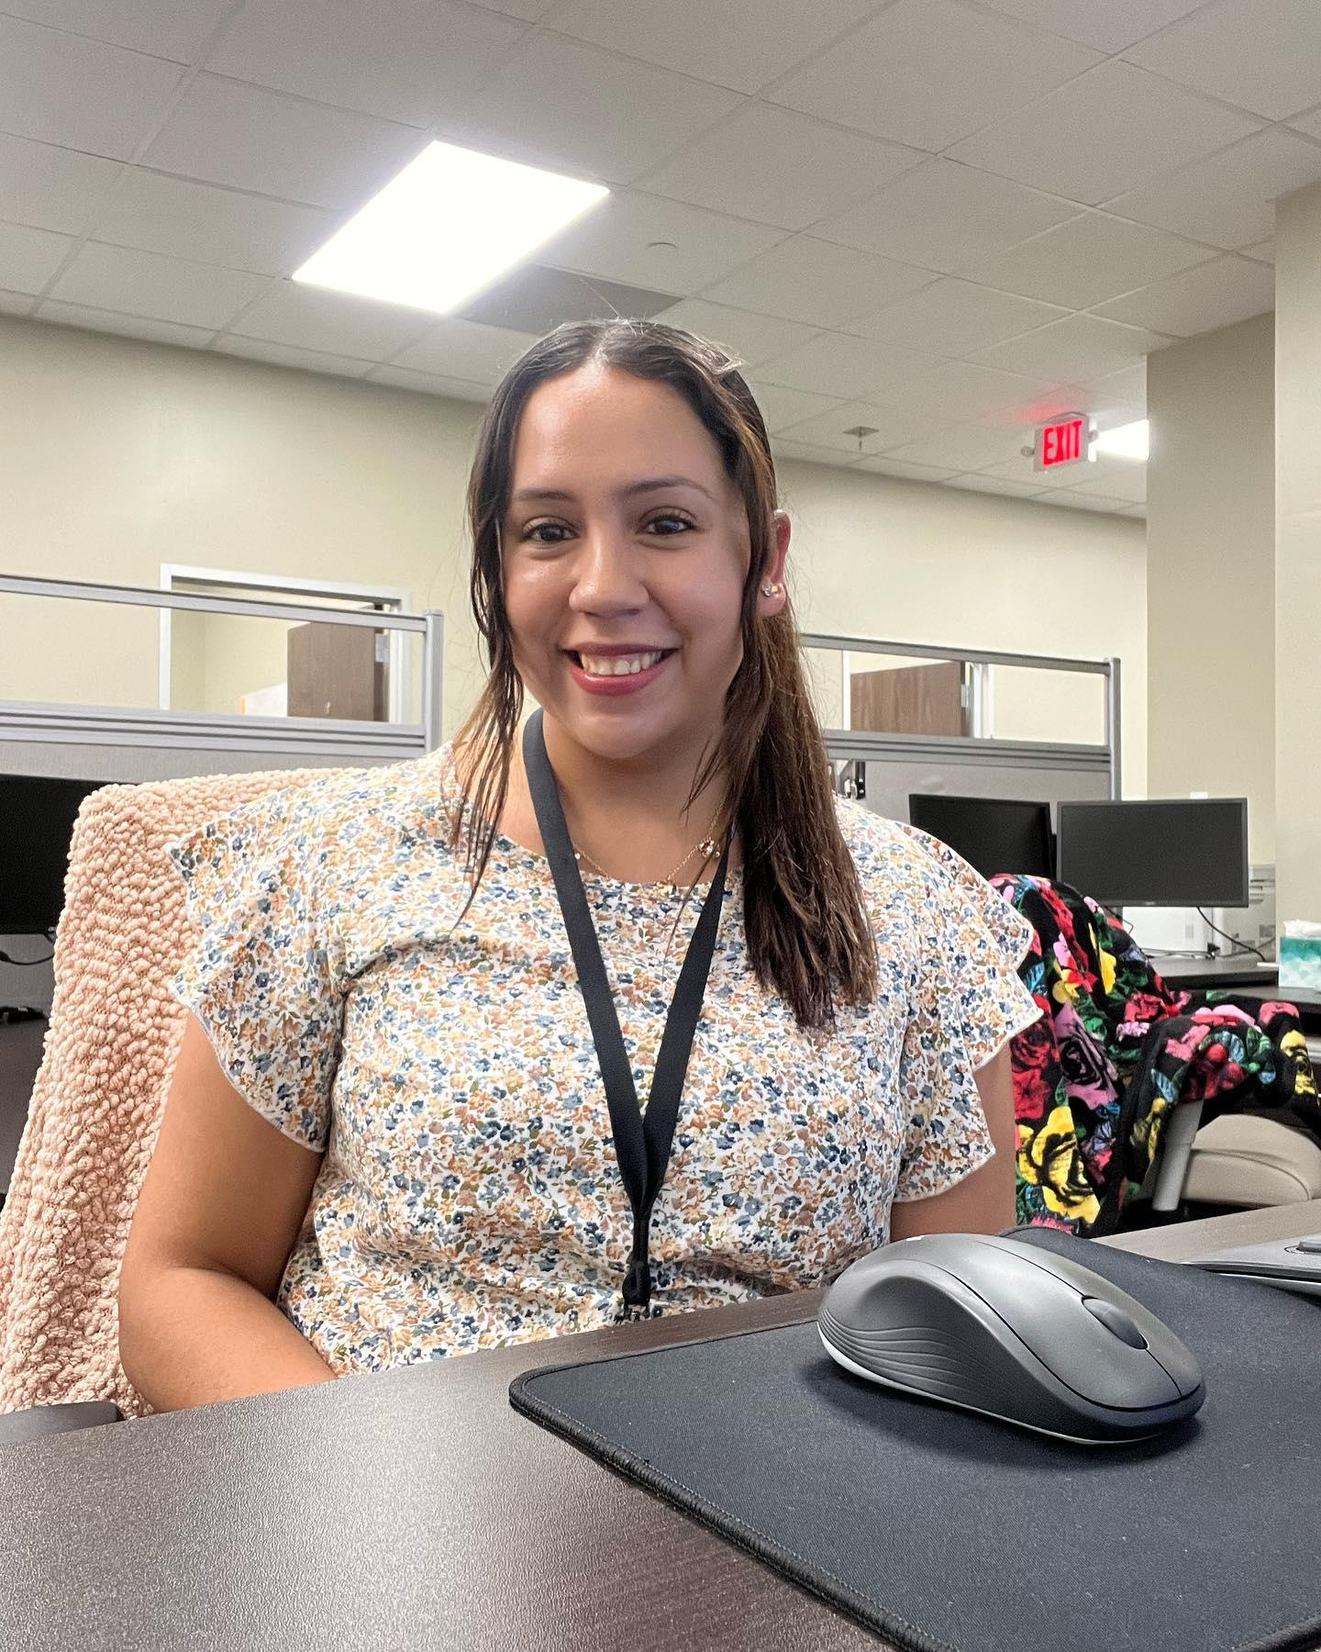
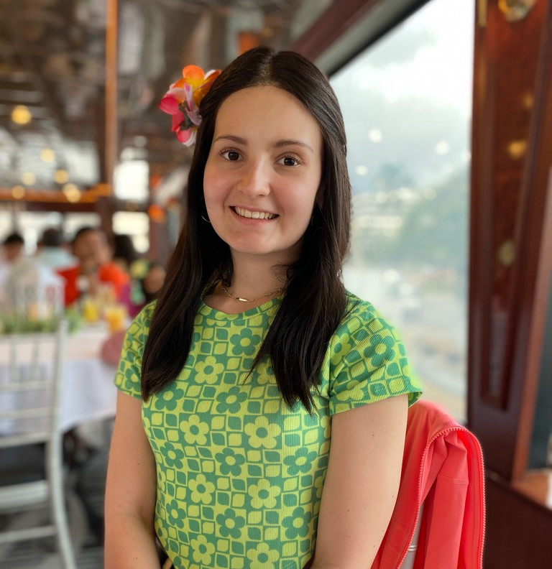
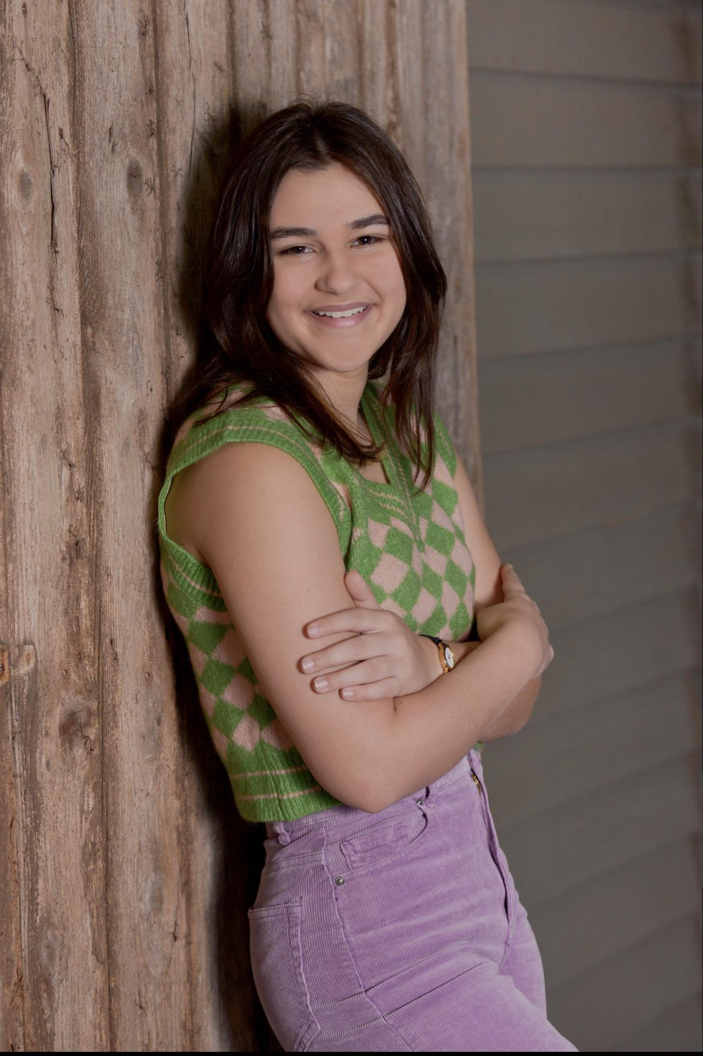
Lucy
Mely
Averey
Event Coordinator
I love planning and having fun, so I hope to be an awesome Event Coordinator this semester! I look forward to meeting this amazing group!
Social Media and Recruitment
I’m excited to learn new skills and work with these amazing ladies while also making friendships in the organization!
Secretary
I learned so much and enjoyed being an officer last semester. I am super excited to be taking on this new role and making new connections this semester.
Notes:
Everyone speaks

Slide 5
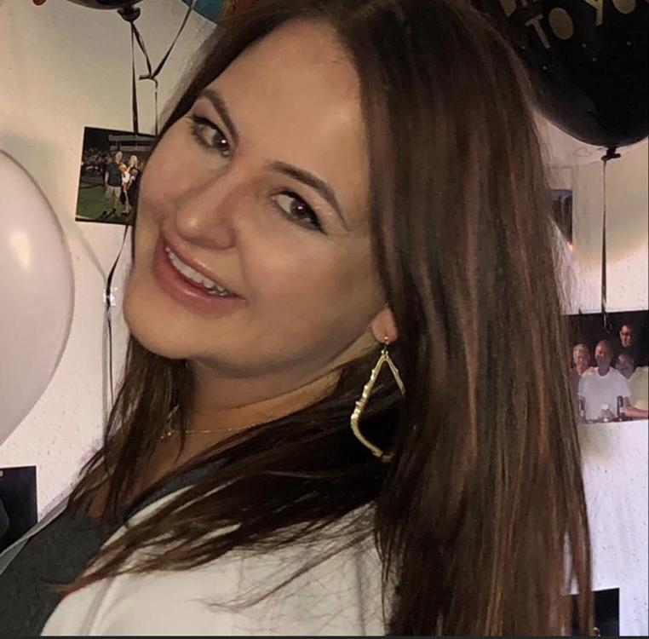
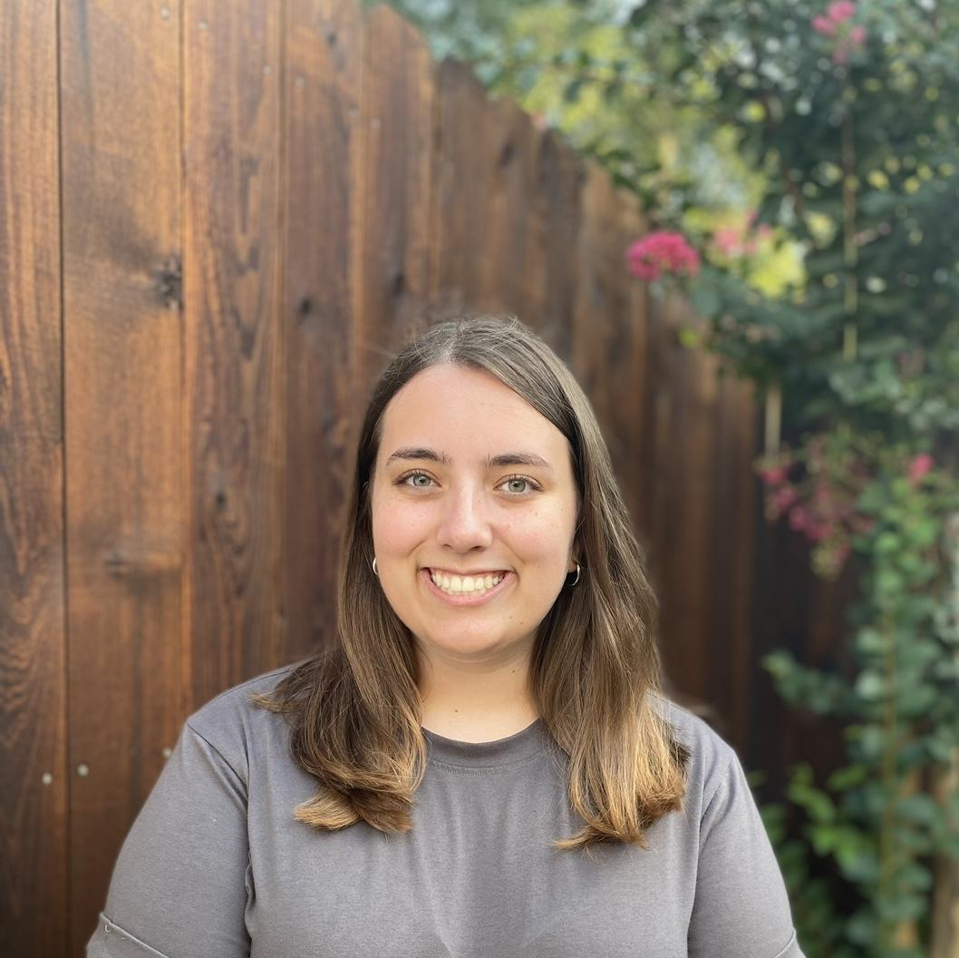
Lauren
Emily
Vice President
My passion for talent and development has grown significantly since I joined SSHRD. I have gained the knowledge and resources to follow my professional goals and I am excited to help other members do the same.
President
I have loved being an officer because I have met so many new people, created fun events, and gained valuable leadership skills! This student org. has given me the opportunity to build connections on campus and in the professional world.
Notes:
Everyone speaks

Slide 6
Important Info
Membership-Points-Opportunities

Slide 7
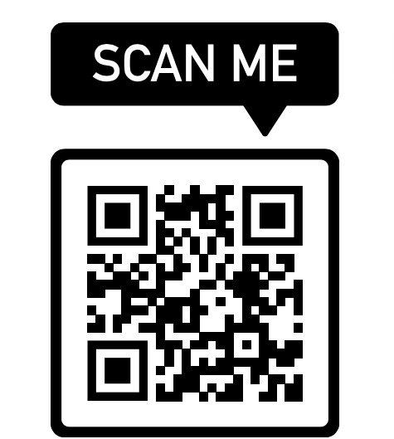
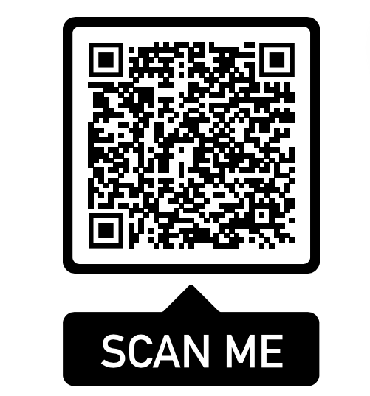
Membership
Early Bird-$25
8/21-9/2
Regular Membership-$35
9/3-9/16
Website
Membership Form
Notes:
Emily

Slide 8
Point System
Monthly Meetings | 10 points
Corporate Visits | 30 points
Guest Speakers | 20 points
Socials | 20 points
Volunteering/Fundraising | 20 points
Point Reduction | No show with no prior notice
NEW: Internship Offer Letter/Proof of Internship | 20 points Once per school year (August 1st-August 1st of the following year) Offer letter must be current and have a date or intended start date
NEW: Tag SSHRD on Instagram | 5 points Must be a technology, engineering, UH, other appropriate school or SSHRD related post
UPDATED: Referral | 10 points Must be applicants first semester joining SSHRD Awarded to both the applicant and referee
Notes:
Emily

Slide 9
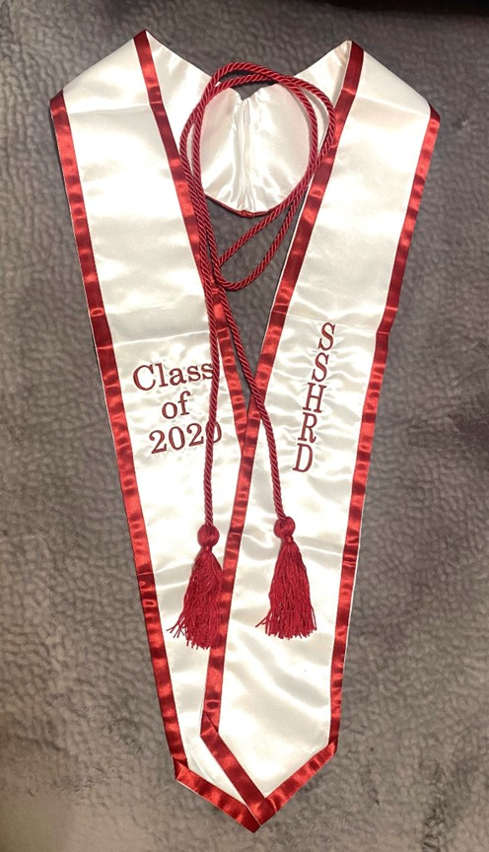
Member Status
Active | 150 points
Bronze | 200 - 299 points
Silver | 300 - 399 points
Gold | 400 - 499 points Members become eligible for a free cord
Platinum | 500 - 599 points Members become eligible for a free stole
Lifetime | 600+ points
Notes:
Emily

Slide 10
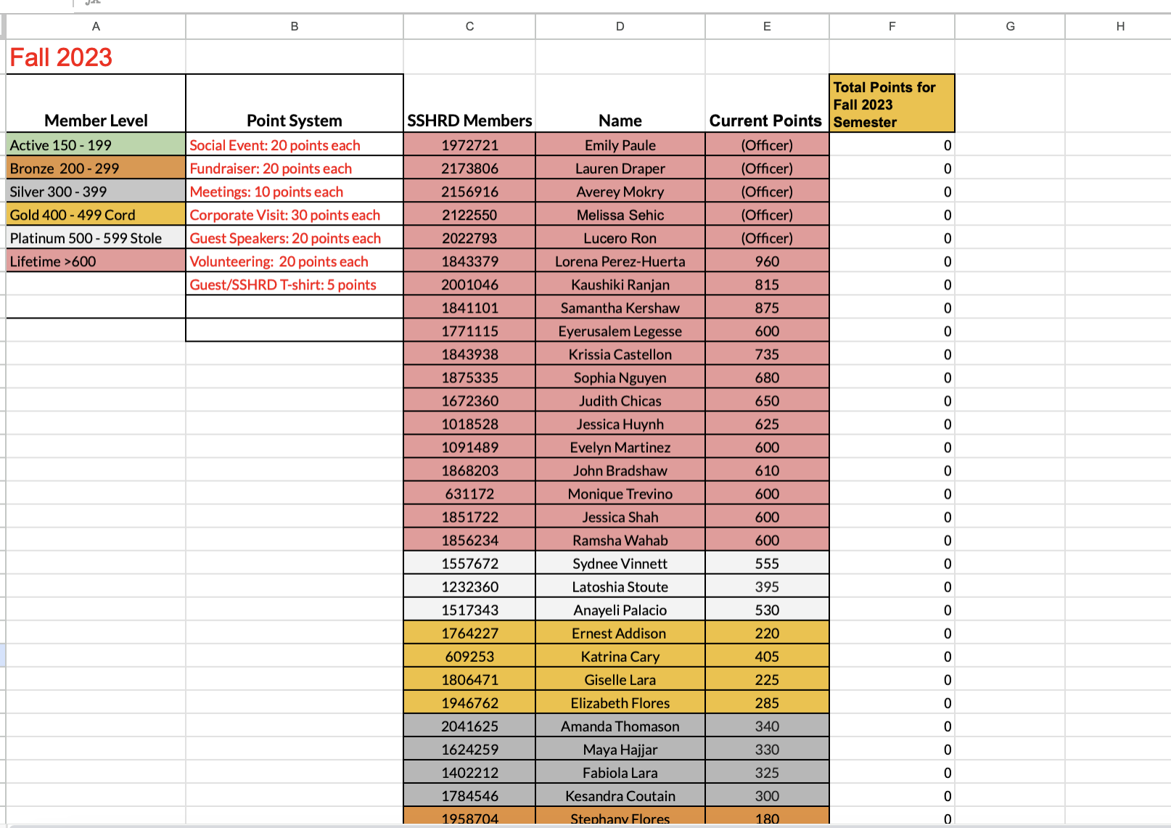
Point Sheet
Notes:
Averey

Slide 11
Mentorship Program
Sign up deadline: Monday, September 2nd
https://forms.gle/8qcfaEtNgMjutQ6U9
Notes:
Lauren

Slide 12
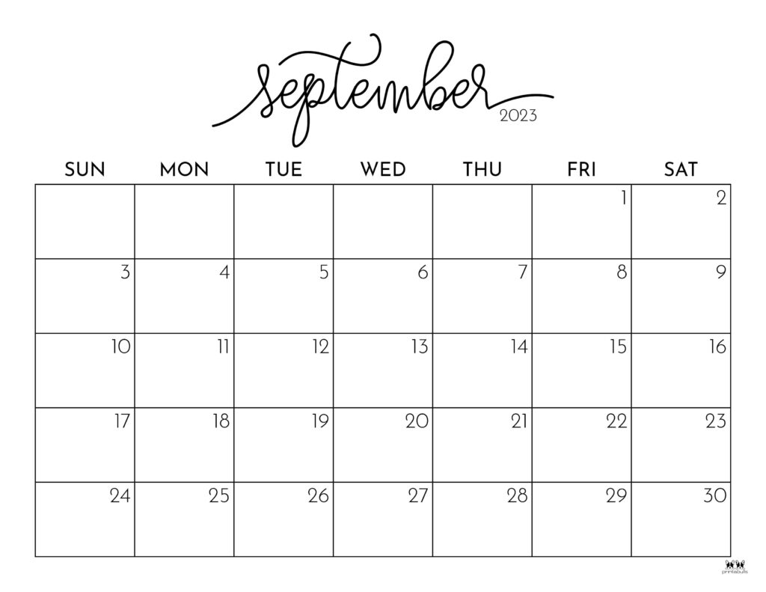
Monthly Calendar
Events:
6th- A Minute With a Mentor
11th- Mentorship Program Starts
13th&14th-Engineering and Technology Career Fair
21st-Meeting Etiquette
23rd-Professional Headshots
30th-Professionalism in Action w/Megan Billnoske
Regular Membership Closes
Notes:
Emily

Slide 13
Connections GroupMe
Please reach out to an Officer if you have not joined the Connections GroupMe.
Notes:
Emily

Slide 14
Professional Development
Notes:
Emily

Slide 15
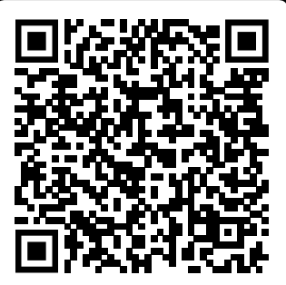
Professional Development
Notes:
Emily

Slide 16
Events and Social
Social
Ice Cream Hangout-Today!
Painting in the Park
Football Game meetup
Game Night
Fundraising
GroupRaise-Restaurant Night
Volunteering
Houston Food Bank
Letters for Veterans
Notes:
Lucy

Slide 17
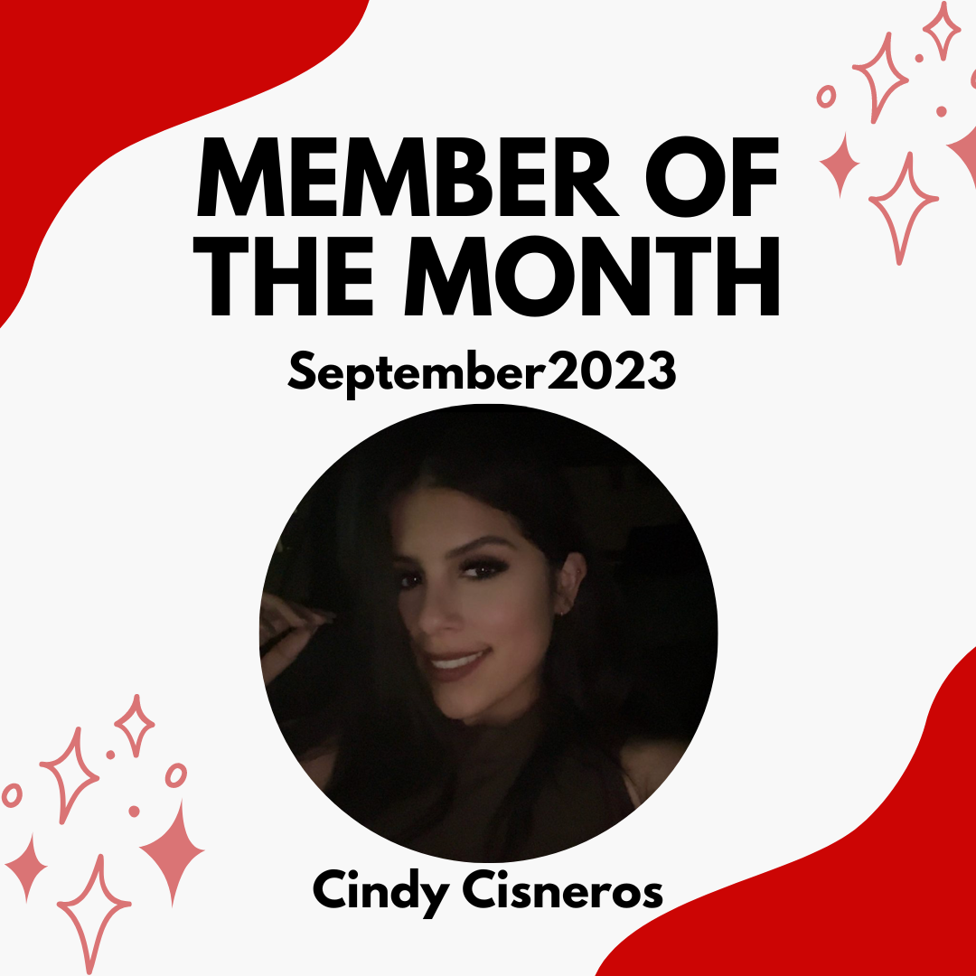
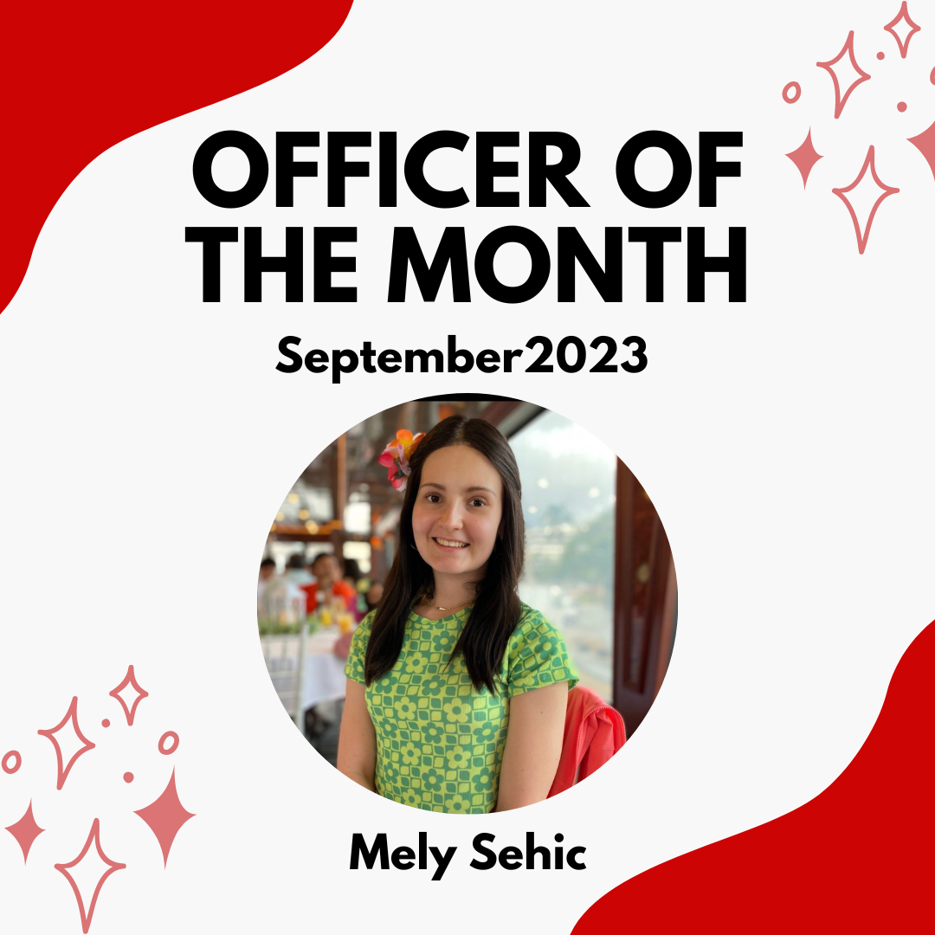
Member of the Month
Officer of the Month
Notes:
Emily

Slide 18
T-Shirt Announcement
Notes:
Lauren

Slide 19
Instagram Raffle
Notes:
Lauren

Slide 20
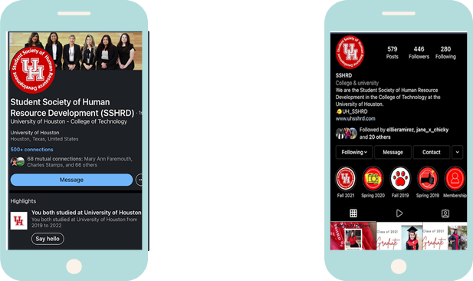
Follow Us
LinkedIn
Student Society of Resource Development
(SSHRD)
Instagram
@uhsshrd
Notes:
Mely

Slide 21
Summer Birthday Shoutouts
June
July
August
- Ernest Addison
- Mahek Lalank
- Po-Yen Huang
- Cynthia Sanchez
- Keanna Lawson
- Lauren Drake
- Anthony Carranza
- Jacqueline Rios
- Zuhair Zahid
- Sara Daredia
- Catherine Canchola
- Grecia Ledezma
Notes:
Mely

Slide 22
September Birthday Shoutouts
Jarielle Afolabi-Craige
Saima Burkie
Asif Islam
Notes:
Mely

Slide 23
Thanks for Attending!
Notes:
Mely

